Slide 1

The Economics of Money, Banking, and Financial Markets
Twelfth Edition, Global Edition
Chapter 5
The Behavior of Interest Rates
Copyright © 2019 Pearson Education, Ltd.
Notes:
If this PowerPoint presentation contains mathematical equations, you may need to check that your computer has the following installed:
1) MathType Plugin
2) Math Player (free versions available)
3) NVDA Reader (free versions available)

Slide 2
Preview
In this chapter, we examine how the overall level of nominal interest rates is determined and which factors influence their behavior.

Slide 3
Learning Objectives (1 of 2)
Identify the factors that affect the demand for assets.
Draw the demand and supply curves for the bond market and identify the equilibrium interest rate.
List and describe the factors that affect the equilibrium interest rate in the bond market.

Slide 4
Learning Objectives (2 of 2)
Describe the connection between the bond market and the money market through the liquidity preference framework.
List and describe the factors that affect the money market and the equilibrium interest rate.
Identify and illustrate the effects on the interest rate of changes in money growth over time.

Slide 5
Determinants of Asset Demand (1 of 2)
Economic agents hold a variety of different assets. What are the primary assets you hold?
An asset is anything that can be owned and has value.

Slide 6
Determinants of Asset Demand (2 of 2)
Wealth: the total resources owned by the individual, including all assets
Expected Return: the return expected over the next period on one asset relative to alternative assets
Risk: the degree of uncertainty associated with the return on one asset relative to alternative assets
Liquidity: the ease and speed with which an asset can be turned into cash relative to alternative assets

Slide 7
Theory of Portfolio Choice (1 of 2)
Holding all other factors constant:
The quantity demanded of an asset is positively related to wealth
The quantity demanded of an asset is positively related to its expected return relative to alternative assets
The quantity demanded of an asset is negatively related to the risk of its returns relative to alternative assets
The quantity demanded of an asset is positively related to its liquidity relative to alternative assets

Slide 8
Theory of Portfolio Choice (2 of 2)
Summary Table 1
Response of the Quantity of an Asset Demanded to Changes in Wealth, Expected Returns, Risk, and Liquidity
Variable | Change in Variable | Change in Quantity Demanded
Wealth | ↑ | ↑
Expected return relative to other assets | ↑ | ↑
Risk relative to other assets | ↑ | ↓
Liquidity relative to other assets | ↑ | ↑
Note: Only increases in the variables are shown. The effects of decreases in the variables on the quantity demanded would be the opposite of those indicated in the rightmost column.

Slide 9
Supply and Demand in the Bond Market
At lower prices (higher interest rates), ceteris paribus, the quantity demanded of bonds is higher: an inverse relationship
At lower prices (higher interest rates), ceteris paribus, the quantity supplied of bonds is lower: a positive relationship

Slide 10
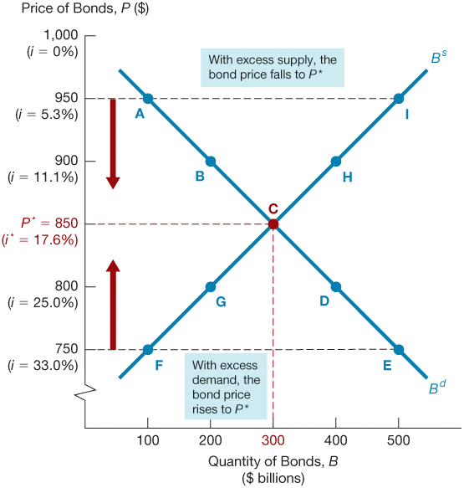
Figure 1 Supply and Demand for Bonds

Slide 11
Market Equilibrium
Occurs when the amount that people are willing to buy (demand) equals the amount that people are willing to sell (supply) at a given price.
B^{d} = B^{s} defines the equilibrium (or market clearing) price and interest rate.
When B^{d} > B^{s} , there is excess demand, price will rise and interest rate will fall.
When B^{d} < B^{s} , there is excess supply, price will fall and interest rate will rise.

Slide 12
Changes in Equilibrium Interest Rates
Shifts in the demand for bonds:
Wealth: in an expansion with growing wealth, the demand curve for bonds shifts to the right
Expected Returns: higher expected interest rates in the future lower the expected return for long-term bonds, shifting the demand curve to the left
Expected Inflation: an increase in the expected rate of inflations lowers the expected return for bonds, causing the demand curve to shift to the left
Risk: an increase in the riskiness of bonds causes the demand curve to shift to the left
Liquidity: increased liquidity of bonds results in the demand curve shifting right

Slide 13
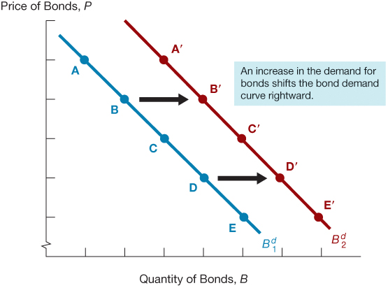
Figure 2 Shift in the Demand Curve for Bonds

Slide 14
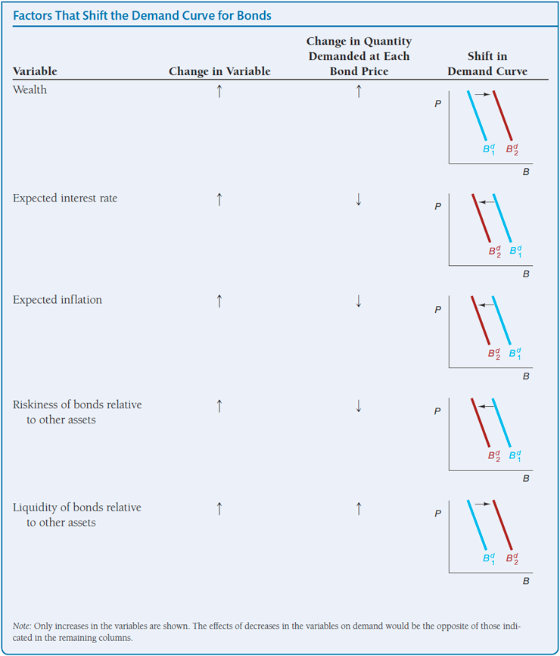
Shifts in the Demand for Bonds
Summary Table 2

Slide 15
Shifts in the Supply of Bonds (1 of 2)
Shifts in the supply for bonds:
Expected profitability of investment opportunities: in an expansion, the supply curve shifts to the right
Expected inflation: an increase in expected inflation shifts the supply curve for bonds to the right
Government budget: increased budget deficits shift the supply curve to the right

Slide 16
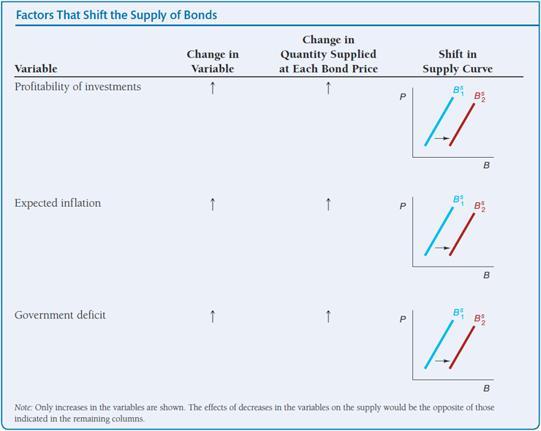
Shifts in the Supply of Bonds (2 of 2)
Summary Table 3

Slide 17
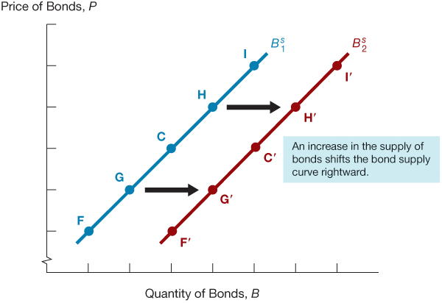
Figure 3 Shift in the Supply Curve for Bonds

Slide 18
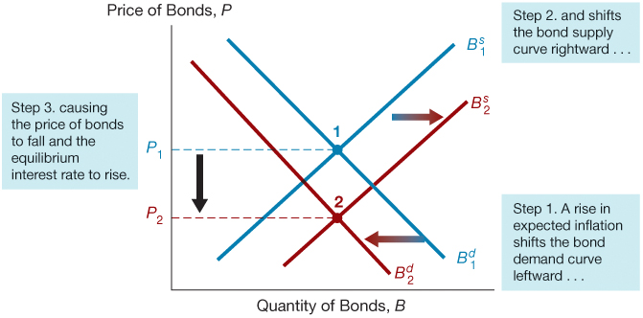
Figure 4 Response to a Change in Expected Inflation

Slide 19
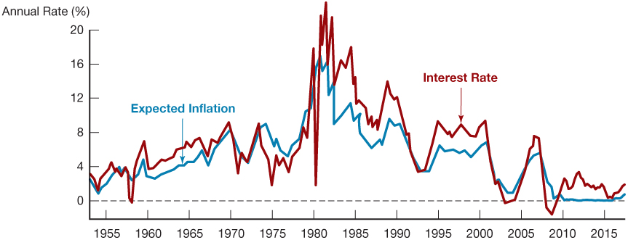
Figure 5 Expected Inflation and Interest Rates (Three-Month Treasury Bills), 1953–2017
Sources: Federal Reserve Bank of St. Louis FRED database: https://fred.stlouisfed.org/series/TB3M; https://fred.stlouisfed.org/series/CPIAUCSL.S. Expected inflation calculated using procedures outlined in Frederic S. Mishkin, “The Real Interest Rate: An EmpiricalInvestigation,” Carnegie-Rochester Conference Series on Public Policy 15 (1981): 151–200. These procedures involve estimating expected inflation as a function of past interest rates, inflation, and time trends.

Slide 20
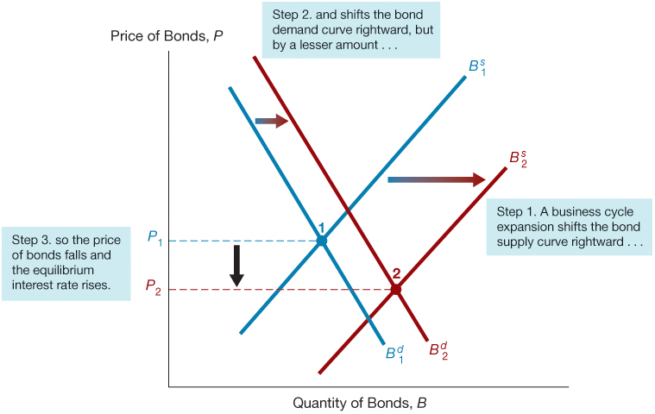
Figure 6 Response to a Business Cycle Expansion

Slide 21
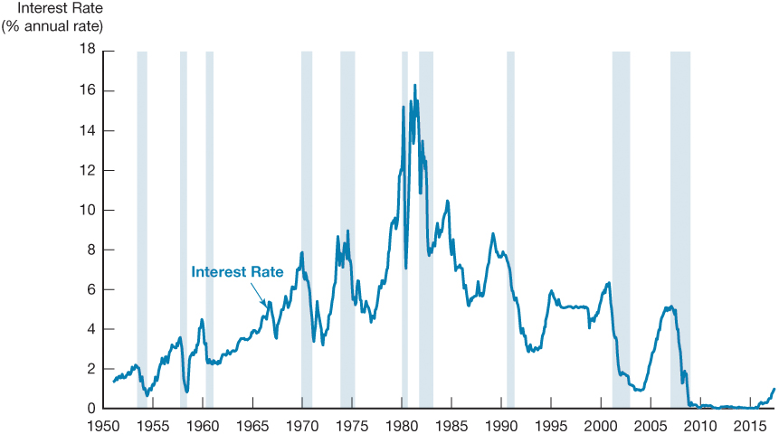
Figure 7 Business Cycle and Interest Rates (Three-Month Treasury Bills), 1951–2017
Source: Federal Reserve Bank of St. Louis FRED database: https://fred.stlouisfed.org/series/TB3MS

Slide 22
Supply and Demand in the Market for Money: The Liquidity Preference Framework (1 of 2)
Keynesian model that determines the equilibrium interest rate in terms of the supply of and demand for money.
There are two main categories of assets that people use to store their wealth: money and bonds.
Total wealth in the economy = B^{s} + M^{s} = B^{d}+ M^{d} Rearranging: B^{s} − B^{d} = M^{s} − M^{d}
If the market for money is in equilibrium (M^{s} = M^{d} ),
then the bond market is also in equilibrium (B^{s} = B^{d} ).

Slide 23
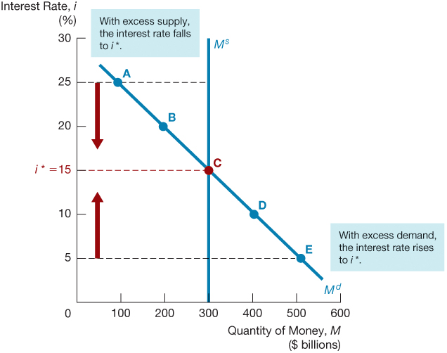
Figure 8 Equilibrium in the Market for Money

Slide 24
Supply and Demand in the Market for Money: The Liquidity Preference Framework (2 of 2)
Demand for money in the liquidity preference framework:
As the interest rate increases:
The opportunity cost of holding money increases…
The relative expected return of money decreases…
…and therefore the quantity demanded of money decreases.

Slide 25
Changes in Equilibrium Interest Rates in the Liquidity Preference Framework (1 of 3)
Shifts in the demand for money:
Income Effect: a higher level of income causes the demand for money at each interest rate to increase and the demand curve to shift to the right
Price-Level Effect: a rise in the price level causes the demand for money at each interest rate to increase and the demand curve to shift to the right

Slide 26
Changes in Equilibrium Interest Rates in the Liquidity Preference Framework (2 of 3)
Shifts in the supply of money:
Assume that the supply of money is controlled by the central bank.
An increase in the money supply engineered by the Federal Reserve will shift the supply curve for money to the right.

Slide 27
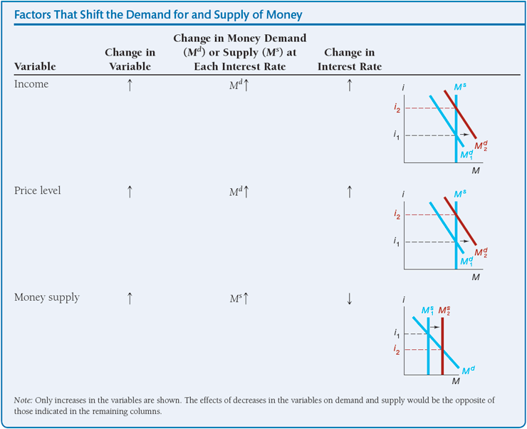
Changes in Equilibrium Interest Rates in the Liquidity Preference Framework (3 of 3)
Summary Table 4

Slide 28
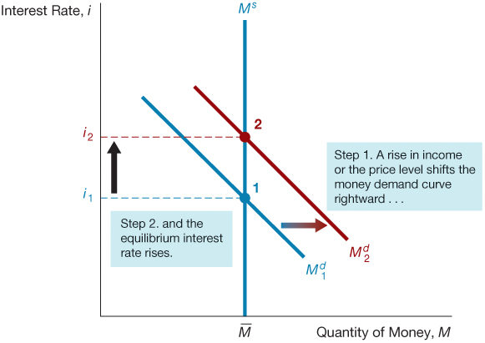
Figure 9 Response to a Change in Income or the Price Level

Slide 29
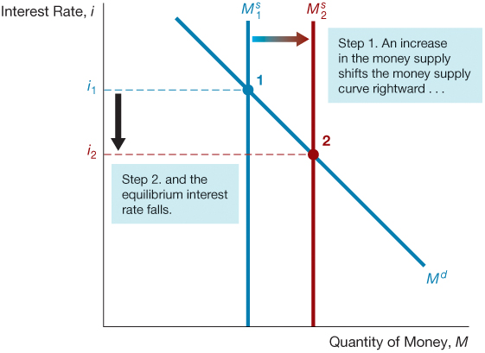
Figure 10 Response to a Change in the Money Supply

Slide 30
Money and Interest Rates
A one time increase in the money supply will cause prices to rise to a permanently higher level by the end of the year. The interest rate will rise via the increased prices.
Price-level effect remains even after prices have stopped rising.
A rising price level will raise interest rates because people will expect inflation to be higher over the course of the year. When the price level stops rising, expectations of inflation will return to zero.
Expected-inflation effect persists only as long as the price level continues to rise.

Slide 31
Does a Higher Rate of Growth of the Money Supply Lower Interest Rates? (1 of 2)
Liquidity preference framework leads to the conclusion that an increase in the money supply will lower interest rates: the liquidity effect.
Income effect finds interest rates rising because increasing the money supply is an expansionary influence on the economy (the demand curve shifts to the right).

Slide 32
Does a Higher Rate of Growth of the Money Supply Lower Interest Rates? (2 of 2)
Price-Level effect predicts an increase in the money supply leads to a rise in interest rates in response to the rise in the price level (the demand curve shifts to the right).
Expected-Inflation effect shows an increase in interest rates because an increase in the money supply may lead people to expect a higher price level in the future (the demand curve shifts to the right).

Slide 33
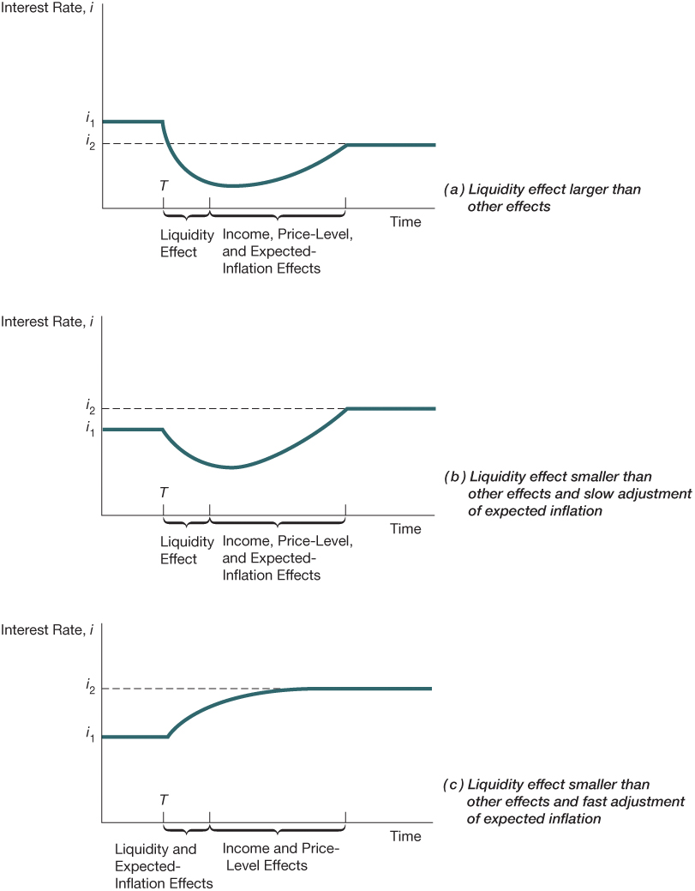
Figure 11 Response over Time to an Increase in Money Supply Growth

Slide 34
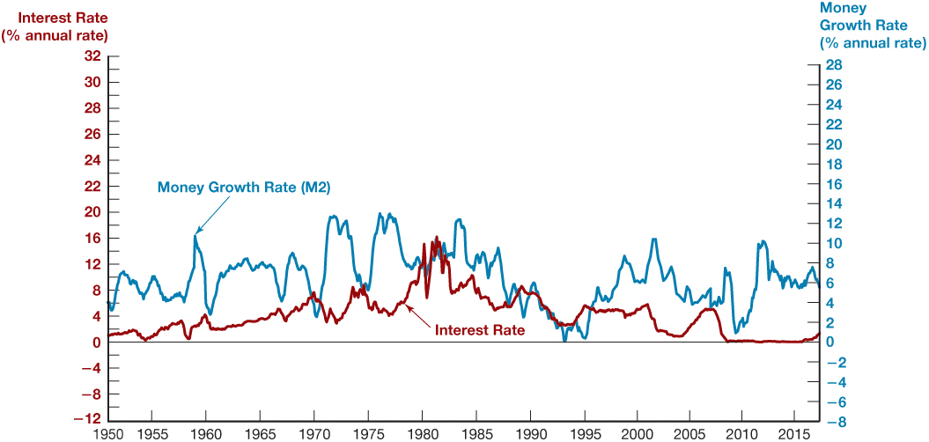
Figure 12 Money Growth (M2, Annual Rate) and Interest Rates (Three-Month Treasury Bills), 1950–2017
Source: Federal Reserve Bank of St. Louis FRED database: https://fred.stlouisfed.org/series/M2SL; https://fred.stlouisfed.org/series/TB3MS

